Slide 1
Session 01 – Course Overview
MIS 6311-501 Cyber Security Fundamentals
Chris Davis

Slide 2
GRC and IT Controls; Building the Security Program
MIS 6311-501 Cyber Security Fundamentals
Chris Davis

Slide 3
Practical Application
IT Controls. GRC. Why do you care?
Presentation delivered at RSA London.
This is a blessedly shortened version.

Slide 4
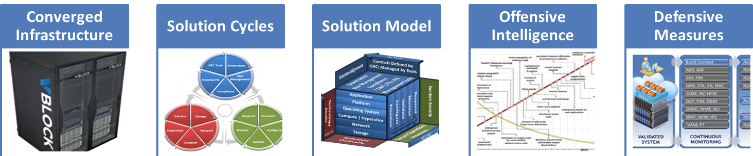
Agenda
Notes:
Lead In:
Purpose:
Transition:
~50 Minutes; Time for Q&A – 10 minutes; 40 Minutes Content
~15 Body Slides
Original Abstract: This session will discuss the challenges of ensuring security and compliance of a converged infrastructure’s virtualization components through the implementation of a formal GRC program based upon the RSA Archer eGRC framework. Focus will be on the architectural best practices of categorizing the discovered components and the use of the automated and manual assessment capabilities of the solution to manage security and compliance.
Flow
Converged Infrastructure – Divergent …
Define Challenges: – Outside of controls; SP; Data access; Setup Environment – business driver
Define Control challenges – too many… coordination across controls – One control meets the objectives of many authorities
Define: Frameworks and Approaches – COBIT (IT GRC); CSA (Industry);
Management Solution: Archer – Implementation; Example; Demo
Canned Demo – See file from Jason
Wrap-up – Lessons (TGOs):

Slide 5

Submarine NR-1
12 Man Crew
Nuclear Powered
Deep Submersible

Slide 6
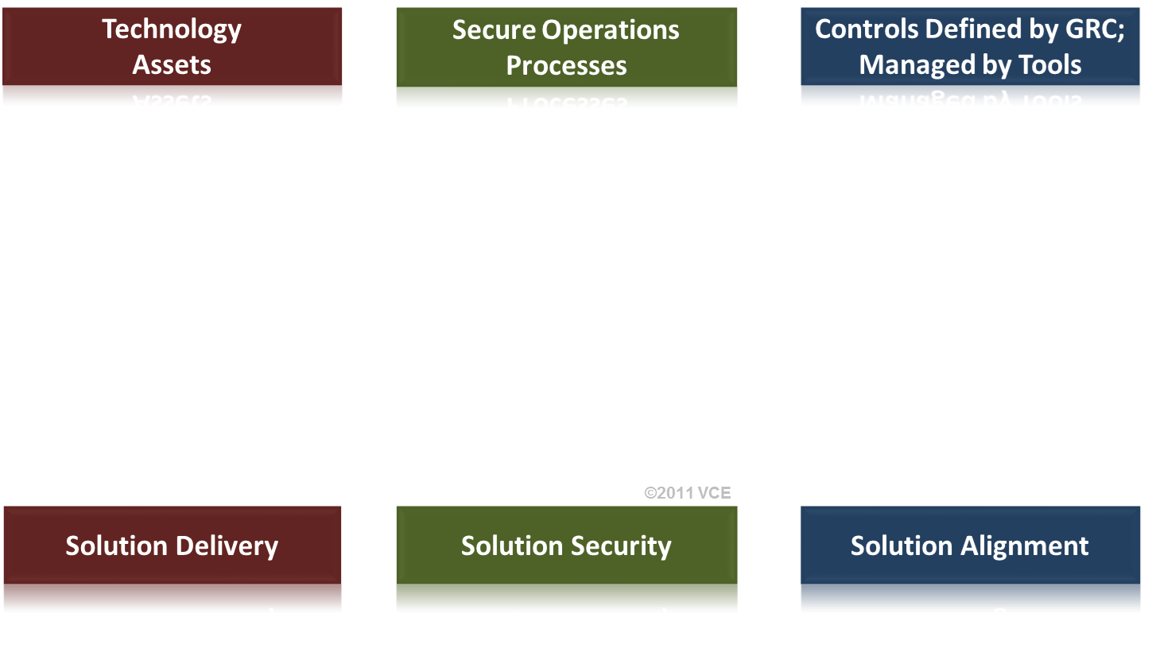
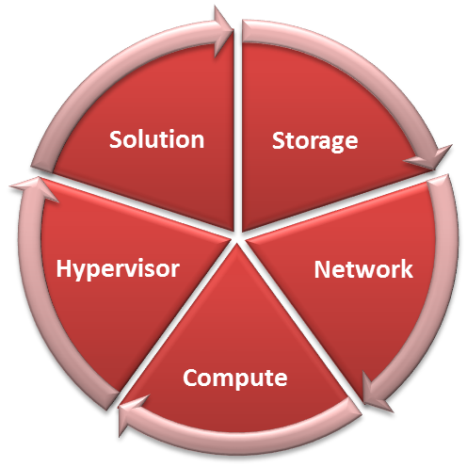
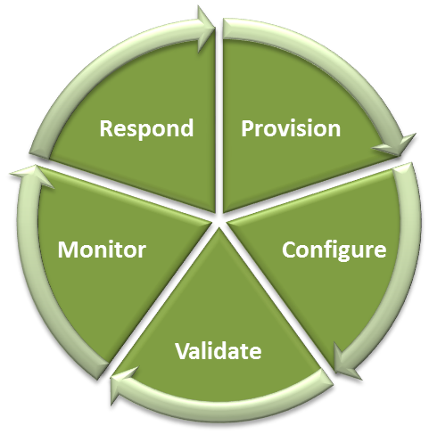
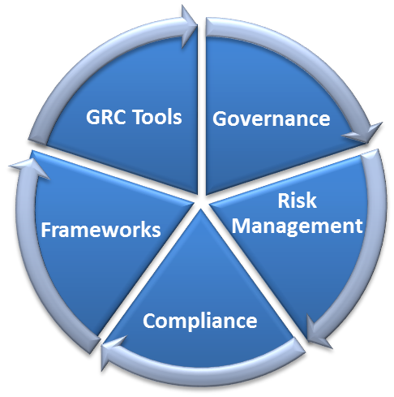
Solution Delivery, Security, and Alignment Security and Assurance Frameworks Are Difficult.
Solution Delivery, Security, and Alignment Cycles
Notes:
Purpose: Discuss each of these as iterative cycles, which fits into the objectives for COBIT, ISO, 800-53(A), ITIL, and nearly every (mature) standard related to security and operational processes. They are NOT checklists. They are cycles. That means there is a feedback control driven by a measurement and compensating mechanism.

Slide 7
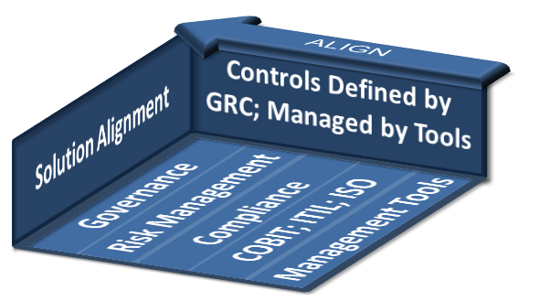
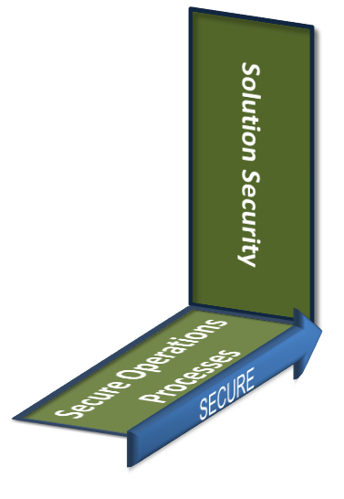



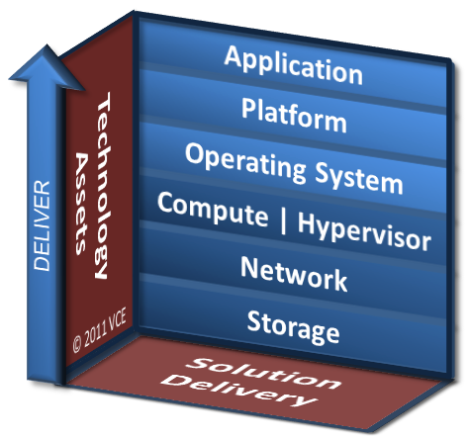


Security is Multidimensional. Not Two. Interrelationships between Infrastructure, Security, and GRC
Monitor
Validate
Configure
Respond
Provision
Key Objectives:
Strategize based on GRC objectives
Processes to identify, acquire technologies to deliver solutions
COBIT PO, AI Domains
Hardware delivery and setup
Key Objectives:
P_{HACK} = 1
Establish processes and relationships to contain and manage incidents
Identify key actors
Establish processes for litigation
Key Objectives:
Set up and align system to your [1] corporate policies (culture), [2] best practices (security), and [3] authorities (compliance)
Includes defining resources and process alignment
Key Objectives:
Review system alignment and risk [1] Config Audit, [2] Vulnerability Assessment (VA)
Baseline review
Periodic reviews
3rd party reviews per risk or requirements
Known Good State
Key Objectives:
Identify changes in systems and communications
FIM; DLP; IPS; CM; AV; SEIM; NetWit.
Changes may be [1] advertent (malicious) or [2] inadvertent (admin errors)
State Deviations
Align technology decisions and processes with your strategic business objectives, risk management, and compliance requirements.
Respond
Provision
Monitor
Configure
Validate
Notes:
Security in 3D – Lets move from the traditional 1D checklist or 2D model to realizing there is more to the story. There is greater context to be had in the infrastructure to understand *why* something is happening. Six Sigma teaches you to ask the 5 Whys. How would you like to pivot into your questions and answers in a 3D fashion? This is coming. We’ll discuss this later.
First, let’s talk about this infrastructure – this architecture – designed to deliver a service. Fundamental processes exist that must be completed to begin operations. Let’s review these. Let’s also review the additional processes and questions that need to be understood prior to an *event*.
… discuss architecture…. Dig into operational processes of the PCVMR Cycle.
Trust = Visibility + Control = Monitoring + Response
Visibility comes from your processes and effective monitoring.
Your ability to react to analysis drives control.

Slide 8

Details of PCVMR Cycle Provision, Configure, Validate, Monitor, Respond
For Session Notes
Provision
Configure
Validate
Key Objectives:
Equip aligned with GRC objectives
Processes to identify, acquire technologies to deliver solutions
COBIT PO, AI Domains
Hardware delivery and setup
Key Objectives:
Set up and align system to your [1] corporate policies (culture), [2] best practices (security), and [3] authorities (compliance)
Includes defining resources and process alignment
Key Objectives:
Review system alignment and risk [1] Config Audit, [2] Vulnerability Assessment (VA)
Baseline and periodic reviews
3rd party reviews per risk or requirements
Known Good State
©2011 VCE
Monitor
Respond
Key Objectives:
Identify changes using internal and external intelligence
FIM; DLP; IPS; CM; AV; SEIM;
Changes may be [1] advertent (e.g. malicious) or [2] inadvertent (e.g. admin errors)
State Deviations
Key Objectives:
P_{HACK} = 1
Establish processes and relationships to contain and manage incidents
Identify key actors
Establish processes for litigation

Slide 9
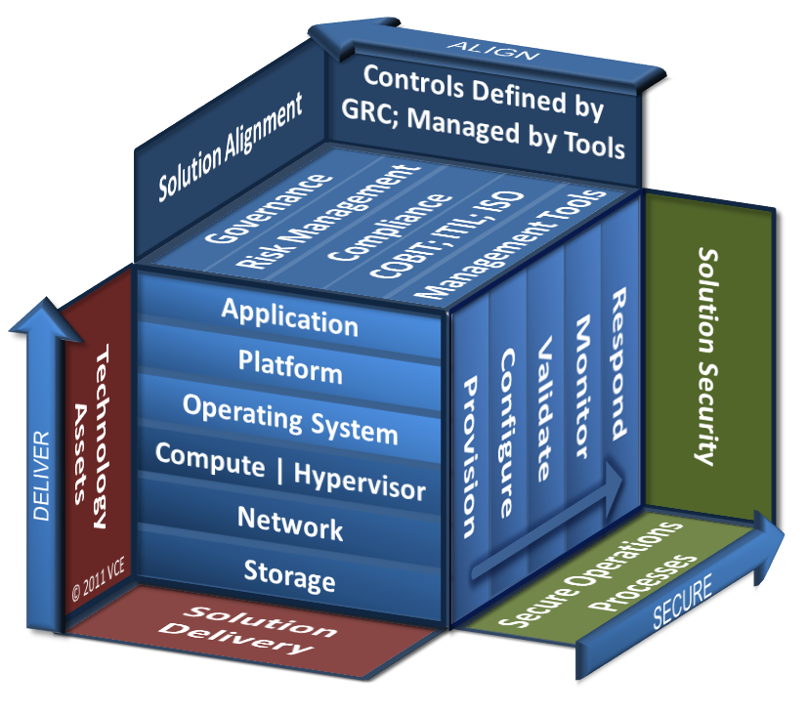
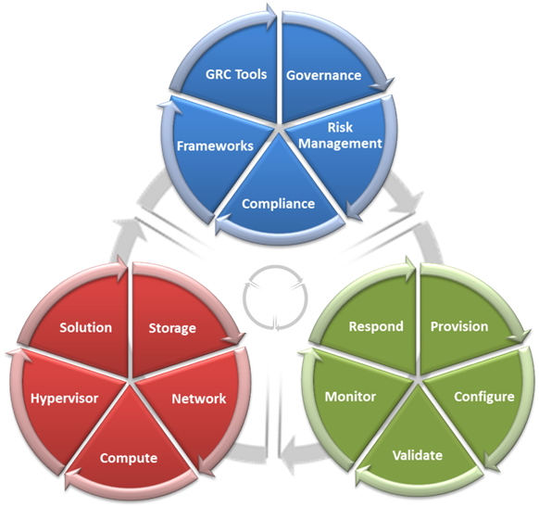


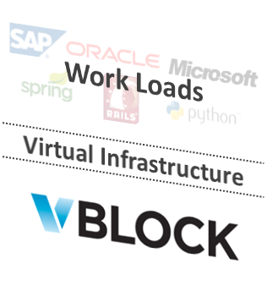
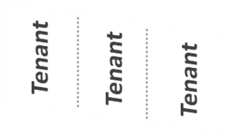
Vblock Platform Working Model
Solution Delivery, Security, and Alignment Cycles

Slide 10


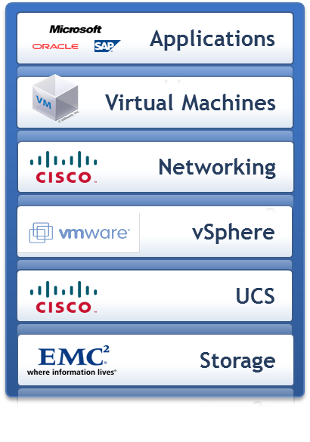

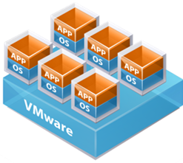
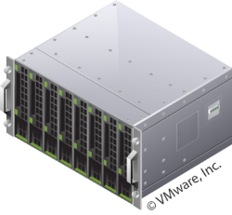
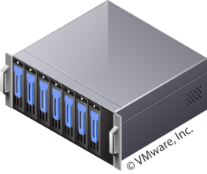
Workflow for Analyzing Security Context: Environment Assurance: Building Sophistication into Analysis
VALIDATED SYSTEM
CONTINUOUS MONITORING
RAPID
RESPONSE
Build Context
Analyze Context
Users
Provisioned Assets
Systems
Configuration
Communications
Services
Identity Access
Third Parties
Object Access
Infrastructure
Data Violations
Actionable Events
Data Locations
Data
Advanced Threats
Manage Workflow
Vulnerabilities
GRC Tools
P
C
V
M
R
Notes:
VAM Vulnerability Assessment and Management Identify and track vulnerabilities
PT Penetration Testing Validate vulnerabilities
SEIM Security Event Information Monitoring Log and correlate environment data
IPS Intrusion Prevention System Identify attacks
FIM File Integrity Monitoring Identify changed files
2FA Two Factor Authentication Authenticate users
IdM Identity Management Provision and deprovision users
AAA Authentication, Authorization, Accounting Identity interaction nonrepudiation
FW Network Firewall Segment and protect networks
AV Server and Endpoint Antivirus Protect against malware
BU System Backups Systems survivability
WAF Web Application Firewall Protect user services
DDOS Distributed Denial of Service Protect user services
DARE Data At Rest Encryption Protect data
DIME Data In Motion Encryption Protect data
DBM Database Monitoring Protect database environment
CM Configuration Management Protect infrastructure
PM Patch Management Protect infrastructure
DLP Data Leakage Protection Identify sensitive data
---
Reminder notes about RSA’s Fraud Detection…
Reduce fraud losses regardless of channel by preventing cybercrime, identity theft, and other threats targeting your customers.
RSA Fraud Management Solutions help reduce fraud losses by preventing unauthorized acquisition and use of such customer information as credentials and identities. Fraud Management Solutions empower you to protect assets, customers, and brand value – all while meeting regulations. You can secure high-value transactions and information while protecting multiple channels, including web, e-commerce, phone, and mobile.
Now, you’ll have clear visibility into how and where your business is losing money, credentials, and identities due to fraud. You’ll know how your business is being targeted – and how to protect against attacks. You’ll improve the efficiency of deploying resources and understand how to safely offer new products and services. And you’ll have a non-invasive form of fraud prevention without changing the user experience.
Key Benefits Real-time detection and fraud prevention - Detect potential abuse, prevent credential theft, and gain insight into emerging threats.
Brand protection - Prevent phishing, pharming, and Trojan attacks to protect financial assets, brand reputation, and consumer confidence.
Cybercrime prevention community - Share cybercrime data 24x7 in real-time across thousands of networked organizations.
RSA will help you build your solution with the following products and services: RSA FraudAction Protect customers from identity theft and external threats such as phishing, pharming, and Trojans, 24x7. RSA Adaptive Authentication Measure indicators to identify high-risk and suspicious activities with this risk-based authentication (RBA) and fraud-detection service. Protect web portals, SSL VPN applications, and web-access-management solutions. RSA Transaction Monitoring Identify fraudulent activity in real-time including such threats as Man-in-the-Browser Trojans. RSA Identity Verification Assure and confirm user identities in real-time with knowledge-based authentication (KBA) that presents top-of-mind questions. RSA Adaptive Authentication for eCommerce Include Verified by Visa®, MasterCard SecureCode™ and JCB J/Secure™ in a framework for cardholder protection, e-commerce authentication, and fraud management. RSA eFraudNetwork Share and disseminate information on fraudulent activity with other members. RSA SecurID Provide more reliable authentication than reusable passwords with two-factor authentication based on something the user knows (a password or PIN) and something the user has (an authenticator). RSA CyberCrime Intelligence Service Provide actionable intelligence to enterprise CISOs and security managers on corporate machines, network resources, access credentials, business data, and email correspondence that may have been compromised by malware.

Slide 11
Common Technical Controls
For Session Notes
Common Required Technical Security Solutions |  |  | Description
1 | VAM | Vulnerability Assessment and Management | Identify and track vulnerabilities
2 | PT | Penetration Testing | Validate vulnerabilities
3 | SEIM | Security Event Information Monitoring | Log and correlate environment data
4 | IPS | Intrusion Prevention System | Identify attacks
5 | FIM | File Integrity Monitoring | Identify changed files
6 | 2FA | Two Factor Authentication | Authenticate users
7 | IdM | Identity Management | Provision and deprovision users
8 | AAA | Authentication, Authorization, Accounting (3A) | Identity interaction nonrepudiation
9 | FW | Network (N) and Host (H) Firewall | Segment and protect networks
10 | AV | Server and Endpoint Antivirus | Protect against malware
11 | BU | System Backups | Systems survivability
12 | DARE | Data At Rest Encryption | Protect data
13 | DIME | Data In Motion Encryption | Protect data
14 | DBM | Database Monitoring | Protect database environment
15 | CM | Configuration Management | Protect infrastructure
16 | PM | Patch Management | Protect infrastructure
17 | WAF* | Web Application Firewall | Protect user services
18 | DLP** | Data Leakage Protection | Identify sensitive data
 | * Specifically called out in some authorities and implied control in others. Highly recommended where the Internet will be the primary use case.
 | ** Not specifically called out in any authority.
Notes:
Sampling of administrative controls: BC/DR Policies; Security Policies; SDLC; SOPs

Slide 12
Analyzing Security Context Environment Assurance: Building Sophistication into Analysis
VALIDATED SYSTEM
CONTINUOUS MONITORING
RAPID
RESPONSE
Build Context
Analyze Context
Users
MO; AM
RSA enVision
Provisioned Assets
Systems
CM; PM
Configuration
Communications
RSA NetWitness
Services
IdM; 2FA; 3A; NAC
Identity Access
Third Parties
RSA FraudAction
SEIM; AV; HFW
Service Monitoring
Infrastructure
DLP; FIM; DBM
Actionable Events
Data Violations
DARE; DIME; BU
Data Locations
Data
WAF; NFW; IPS
Advanced Threats
Manage Workflow
VAM; PT
Vulnerabilities
GRC Tools
RSA Archer
P
C
V
M
R
Notes:
VAM Vulnerability Assessment and Management Identify and track vulnerabilities
PT Penetration Testing Validate vulnerabilities
SEIM Security Event Information Monitoring Log and correlate environment data
IPS Intrusion Prevention System Identify attacks
FIM File Integrity Monitoring Identify changed files
2FA Two Factor Authentication Authenticate users
IdM Identity Management Provision and deprovision users
AAA Authentication, Authorization, Accounting Identity interaction nonrepudiation
FW Network Firewall Segment and protect networks
AV Server and Endpoint Antivirus Protect against malware
BU System Backups Systems survivability
WAF Web Application Firewall Protect user services
DDOS Distributed Denial of Service Protect user services
DARE Data At Rest Encryption Protect data
DIME Data In Motion Encryption Protect data
DBM Database Monitoring Protect database environment
CM Configuration Management Protect infrastructure
PM Patch Management Protect infrastructure
DLP Data Leakage Protection Identify sensitive data
NFW Network Firewall Segment and protect networks
HFW Host Firewall Protect against network attacks
---
Reminder notes about RSA’s Fraud Detection…
Reduce fraud losses regardless of channel by preventing cybercrime, identity theft, and other threats targeting your customers.
RSA Fraud Management Solutions help reduce fraud losses by preventing unauthorized acquisition and use of such customer information as credentials and identities. Fraud Management Solutions empower you to protect assets, customers, and brand value – all while meeting regulations. You can secure high-value transactions and information while protecting multiple channels, including web, e-commerce, phone, and mobile.
Now, you’ll have clear visibility into how and where your business is losing money, credentials, and identities due to fraud. You’ll know how your business is being targeted – and how to protect against attacks. You’ll improve the efficiency of deploying resources and understand how to safely offer new products and services. And you’ll have a non-invasive form of fraud prevention without changing the user experience.
Key Benefits Real-time detection and fraud prevention - Detect potential abuse, prevent credential theft, and gain insight into emerging threats.
Brand protection - Prevent phishing, pharming, and Trojan attacks to protect financial assets, brand reputation, and consumer confidence.
Cybercrime prevention community - Share cybercrime data 24x7 in real-time across thousands of networked organizations.
RSA will help you build your solution with the following products and services: RSA FraudAction Protect customers from identity theft and external threats such as phishing, pharming, and Trojans, 24x7. RSA Adaptive Authentication Measure indicators to identify high-risk and suspicious activities with this risk-based authentication (RBA) and fraud-detection service. Protect web portals, SSL VPN applications, and web-access-management solutions. RSA Transaction Monitoring Identify fraudulent activity in real-time including such threats as Man-in-the-Browser Trojans. RSA Identity Verification Assure and confirm user identities in real-time with knowledge-based authentication (KBA) that presents top-of-mind questions. RSA Adaptive Authentication for eCommerce Include Verified by Visa®, MasterCard SecureCode™ and JCB J/Secure™ in a framework for cardholder protection, e-commerce authentication, and fraud management. RSA eFraudNetwork Share and disseminate information on fraudulent activity with other members. RSA SecurID Provide more reliable authentication than reusable passwords with two-factor authentication based on something the user knows (a password or PIN) and something the user has (an authenticator). RSA CyberCrime Intelligence Service Provide actionable intelligence to enterprise CISOs and security managers on corporate machines, network resources, access credentials, business data, and email correspondence that may have been compromised by malware.

Slide 13
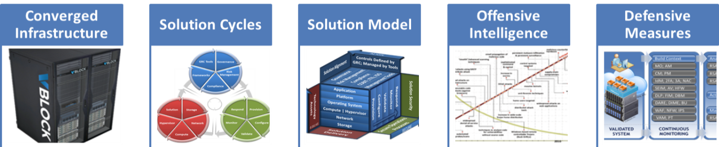
Session Wrap How can we apply what we discussed today?
OUR DISCUSSION
© 2011 VCE
OUR APPLICATION: Next Steps
© 2011 VCE
Specific Actions
Specific Actions
Evaluate Current State:
Project: Context Collection Review
Asset Inventory
Project: Context Analysis Review
Data Inventory
Project: Response Execution Review
Control Inventory
Notes:
Sessions focused primarily on infrastructure issues (e.g., Data Security, Strategy & Architecture sessions), should provide:
2 – 5 specific actions that attendees could implement within 3 months of returning to the office
Specific considerations necessary (e.g., type of OS, type of network topology, specific protocols impacted, etc.) to implement specific actions provided
Sessions focused primarily on potential threats (e.g., Hackers & Threats sessions), should provide:
Specific information about the threat(s) that attendees can use to validate their organization’s exposure to the threat(s) discussed
Specific remediation actions for the threat(s) discussed.
Example Apply Slide: How to Apply What You Have Learned Today
In the first three months following this presentation you should:
Identify a critical database.
Understand who is accessing the data in the database and from where.
Define appropriate controls for the database.
Within six months you should:
Select a security system which allows proactive policy to be set according to your organization’s needs.
Drive an implementation project to protect all critical databases.

Slide 14
Chris Davis
UTD Email: cmd140430@utdallas.edu
Google Voice: 214-771-8122
Course Materials
https://elearning.utdallas.edu

Slide 15
Additional Materials

